Slide 1

BSAI Flathead Sole Complex
Cole Monnahan & Rebecca Haehn
November 2020 Plan Team

Slide 2
Brief intro & background
Tier 3a model, full assessment even years
Complex comprises flathead sole and Bering flounder (~0.2% catch)
Caught by non-pelagic trawl primarily, but ~15-30% from pelagic trawl
The model is very stable and consistent among variants with low retrospective bias

Slide 3
Model Structure
Sex- and age-structured stock synthesis v3.30 (ages 3-21+)
Sex-specific selectivity:
Fishery: length, dome-shaped, blocks
Survey: age, logistic
Sex-specific growth estimated internally using conditional age-at-length data
Estimated early recruitments for initial age structure
Francis data weighting used

Slide 4
Model Structure
Parameters estimated outside the model:
Natural mortality (M=0.2, both sexes)
σ_{R}=0.5
q=1 (no temperature link)
Maturity (50% at 9.7 yrs, 95% at 12.8)
Ageing error matrix, length-weight relationship
1:1 sex ratio

Slide 5
Executive Summary
Quantity | As estimated or |  | As estimated or
 | specified last year for: |  | recommended this year for:
 | 2020 | 2021 | 2021* | 2022*
M (natural mortality rate) | 0.2 | 0.2 | 0.2 | 0.2
Tier | 3a | 3a | 3a | 3a
Projected biomass (3+) (t) | 684,768 | 692,915 | 602,497 | 608,576
Projected SSB (t) | 154,195 | 160,864 | 150,433 | 154,906
B_{100%} | 212,060 | 212,060 | 203,658 | 203,658
B_{40%} | 84,824 | 84,824 | 81,463 | 81,463
B_{35%} | 74,221 | 74,221 | 71,280 | 71,280
F_{OFL} | 0.47 | 0.47 | 0.46 | 0.46
maxF_{ABC} | 0.38 | 0.38 | 0.37 | 0.37
F_{ABC} | 0.38 | 0.38 | 0.37 | 0.37
OFL (t) | 82,810 | 86,432 | 75,863 | 77,763
maxABC (t) | 68,134 | 71,079 | 62,567 | 64,119
ABC (t) | 68,134 | 71,079 | 62,567 | 64,119
Projections based on estimated catch:
8,669 t in 2020
11,519 t in 2021
11,519 t in 2022
62,567 t is 8.17% decrease in ABC from 2020

Slide 6
Changes in assessment inputs
Updated catch biomass (final for 2018 and 2019; 2020 extrapolated catch)
Fishery ages (2018-2019)
Fishery lengths (2020)
2019 EBS shelf survey biomass & updated linear regression to predict missing AI years
Survey ages (1999, 2018-2019)
Survey lengths (2019)

Slide 7
Changes in assessment methodology
2018 model included major improvements and exploration based on CIE review.
Resulting model is very stable and consistent among alternatives.
2018 accepted model: 18.2c
No new models considered: 18.2c (2020)

Slide 8
Changes in assessment methodology
SSC October 2019: The SSC recommends the authors complete the risk table and note important concerns or issues associated with completing the table.
Risk table added, no areas of concern were found (all level 1) so no reduction from maxABC recommended

Slide 9
Response to SSC comments
December 2018 SSC: The author notes that average summer bottom temperature may not be adequate to describe the relationship among the environmental drivers of flathead sole stock distribution and behavior. The SSC recommends that this continue to be explored.
No exploration of environmental drivers were done this year. Using spatially-varying coefficient models in VAST seem promising alternative

Slide 10
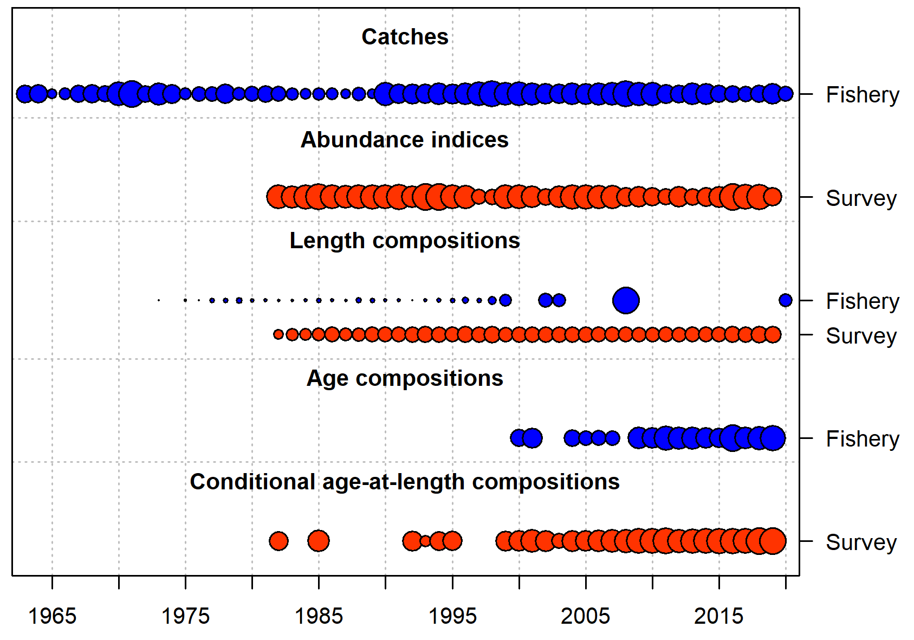
Data inputs

Slide 11
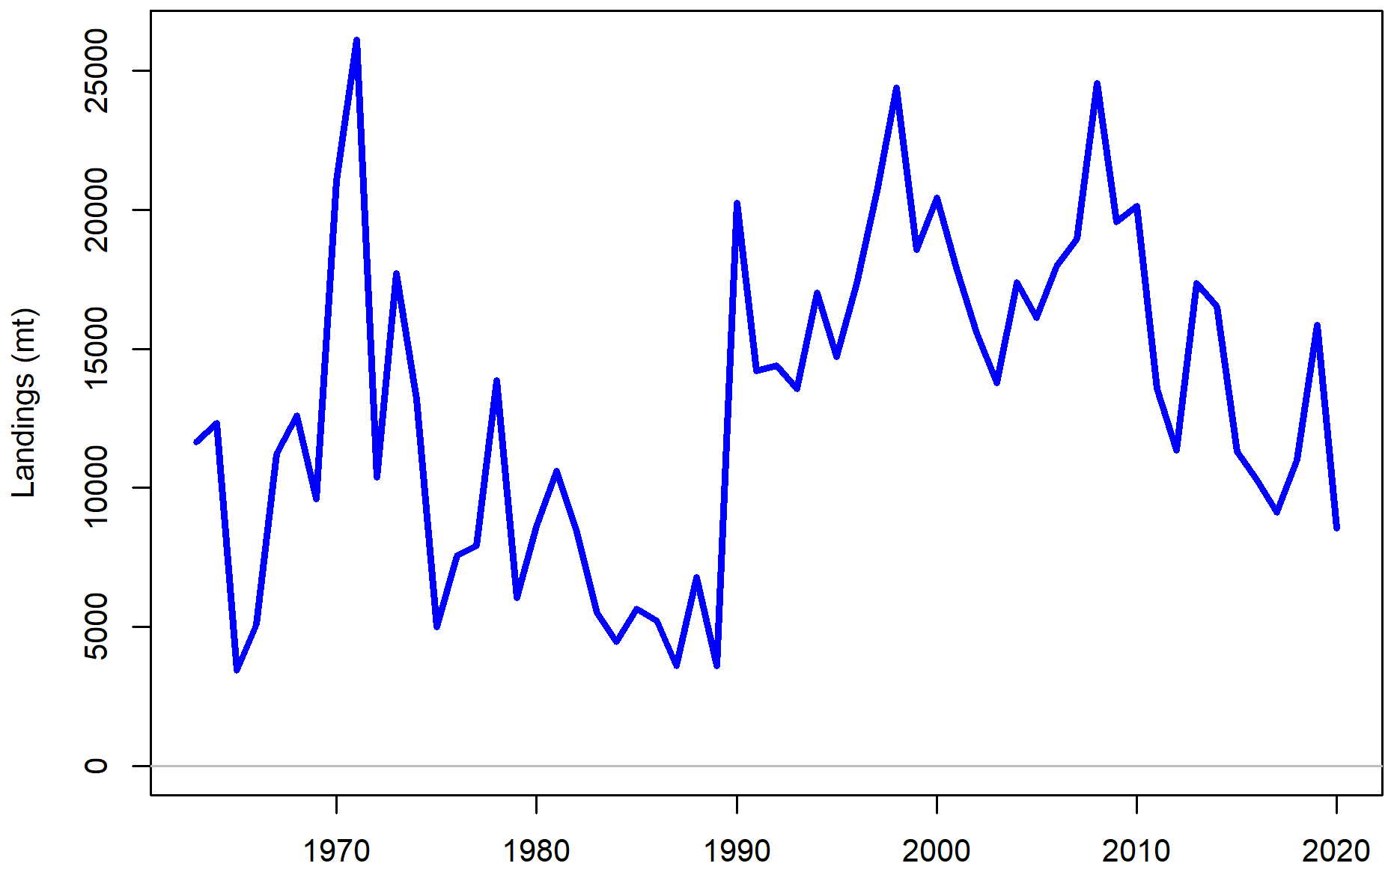
Data inputs: catch history

Slide 12
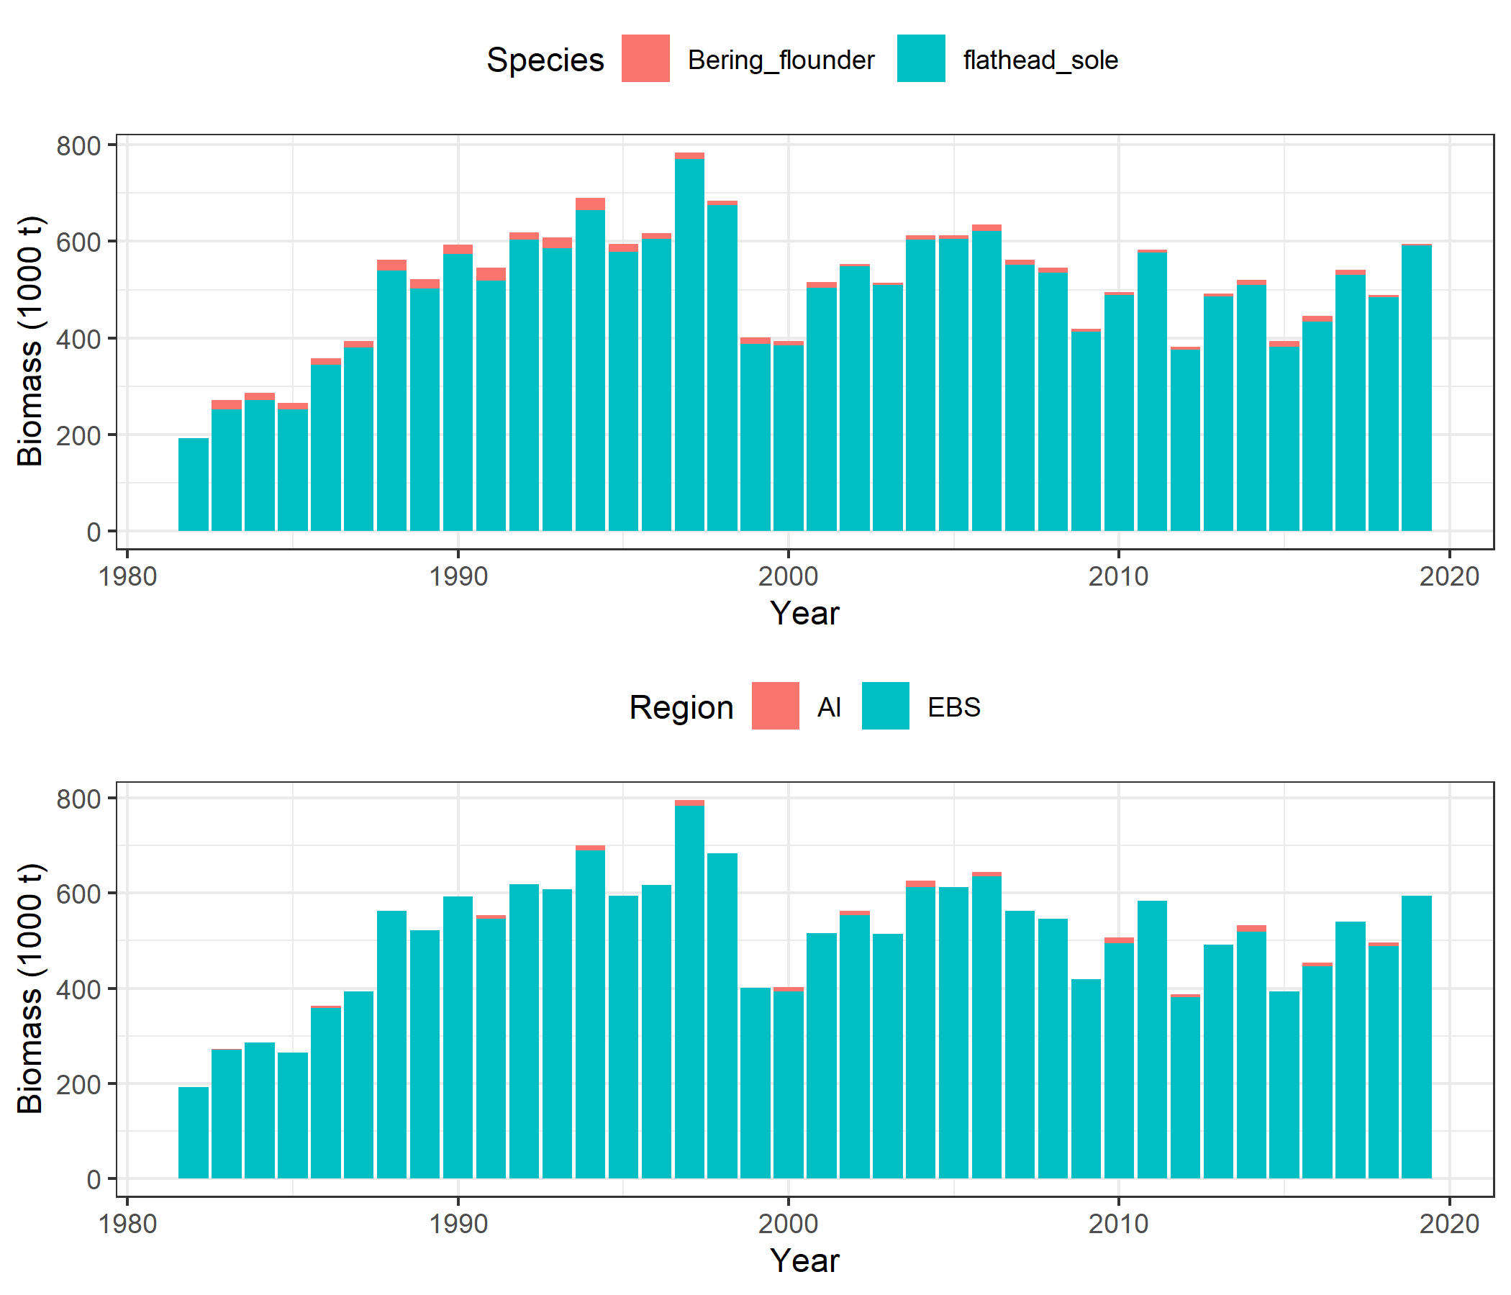
Catch distribution

Slide 13
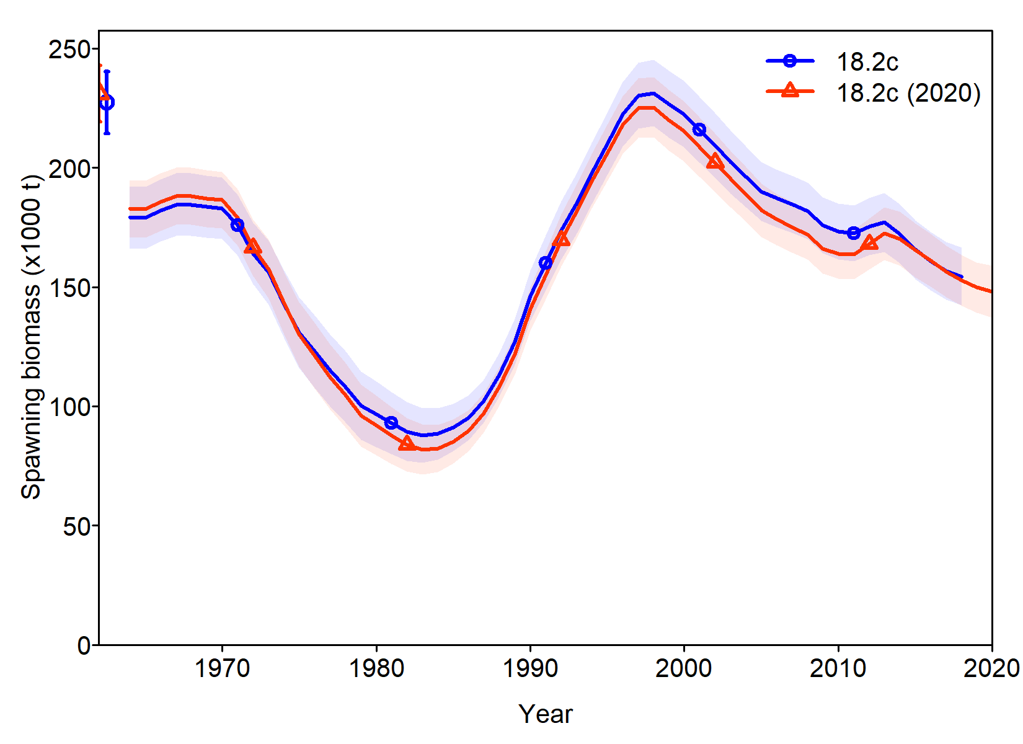
Stable SSB trends

Slide 14
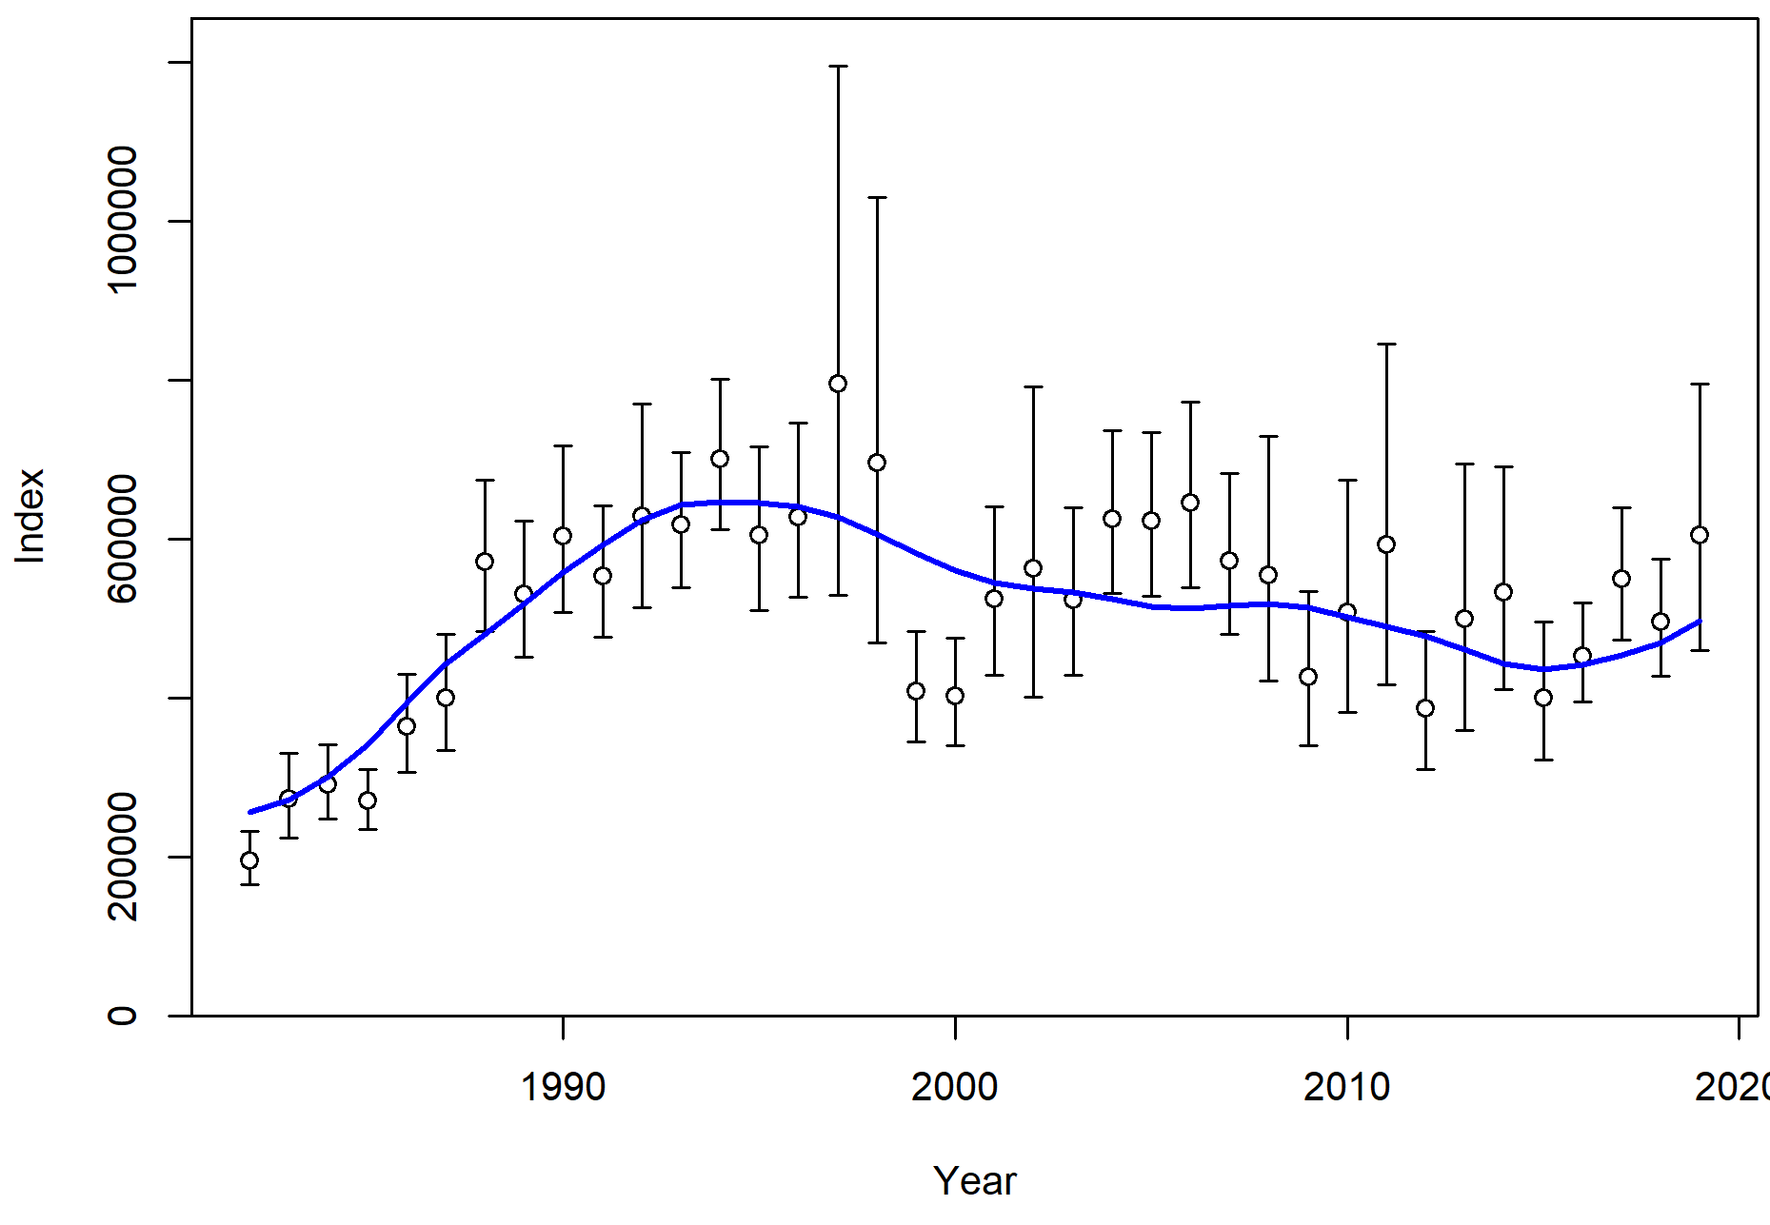
Good fit to index

Slide 15
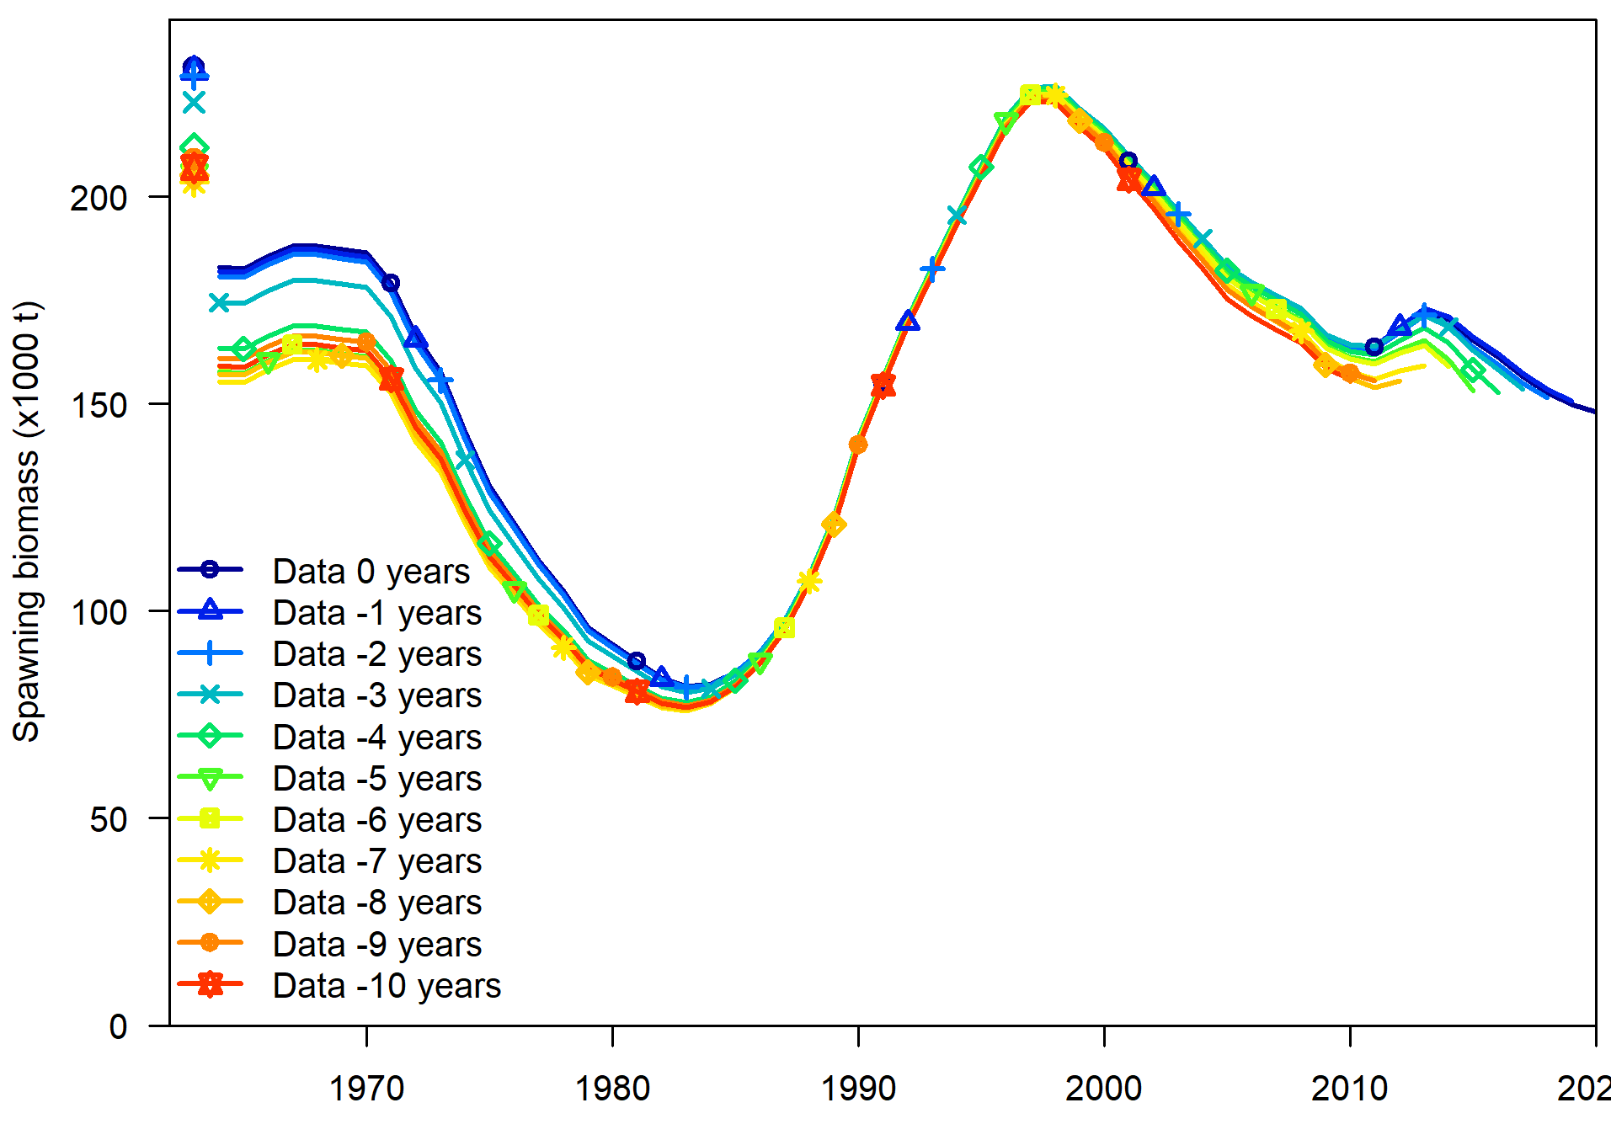
Good retrospective patterns

Slide 16
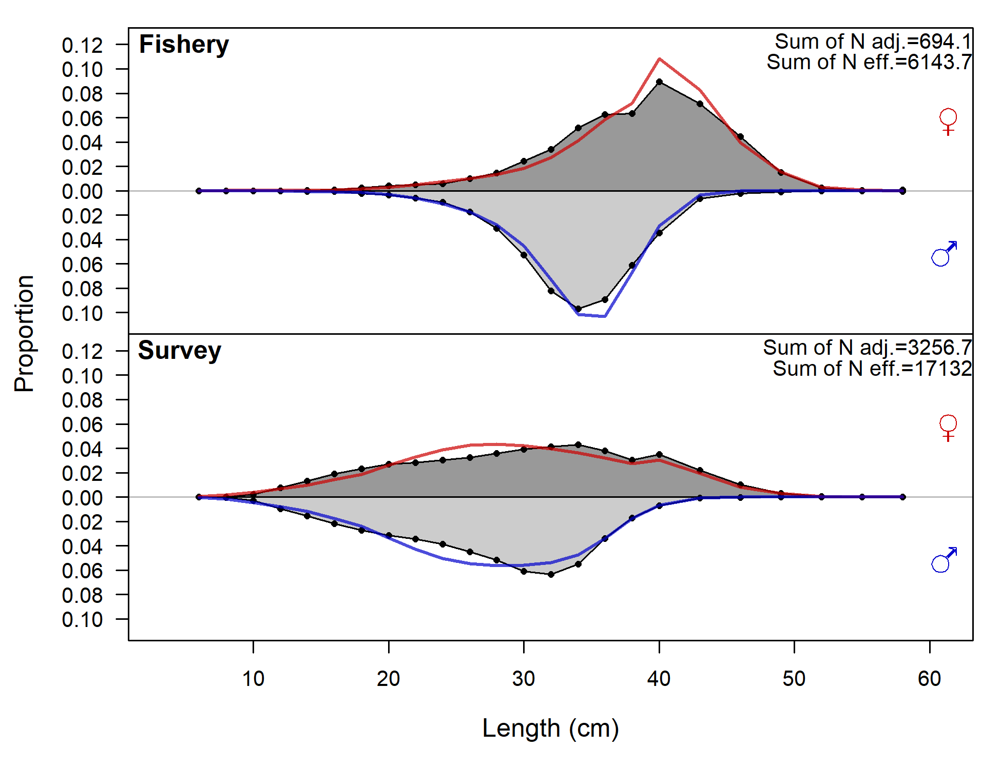
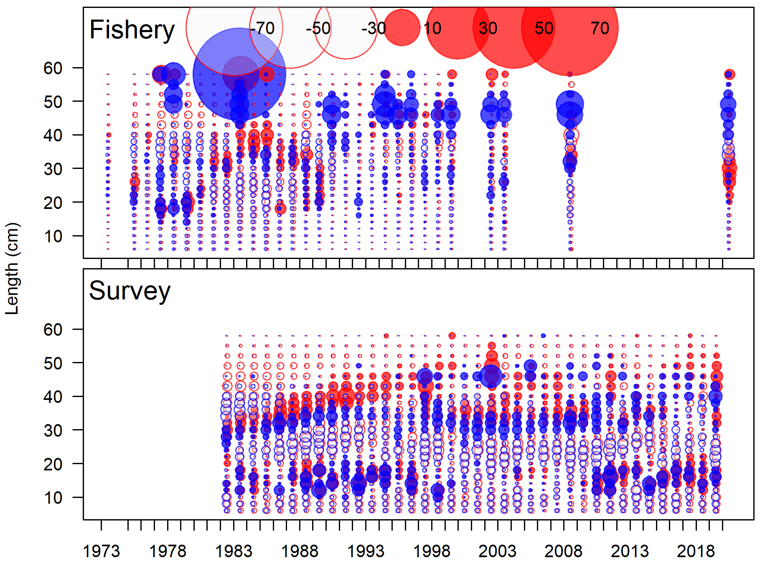
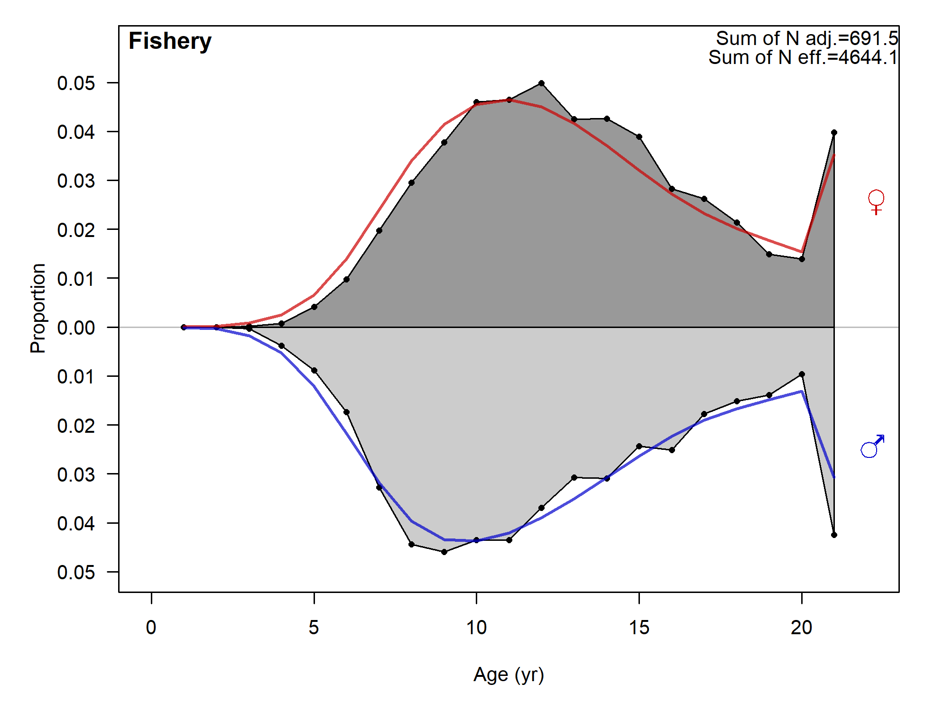
Pretty good composition fits

Slide 17
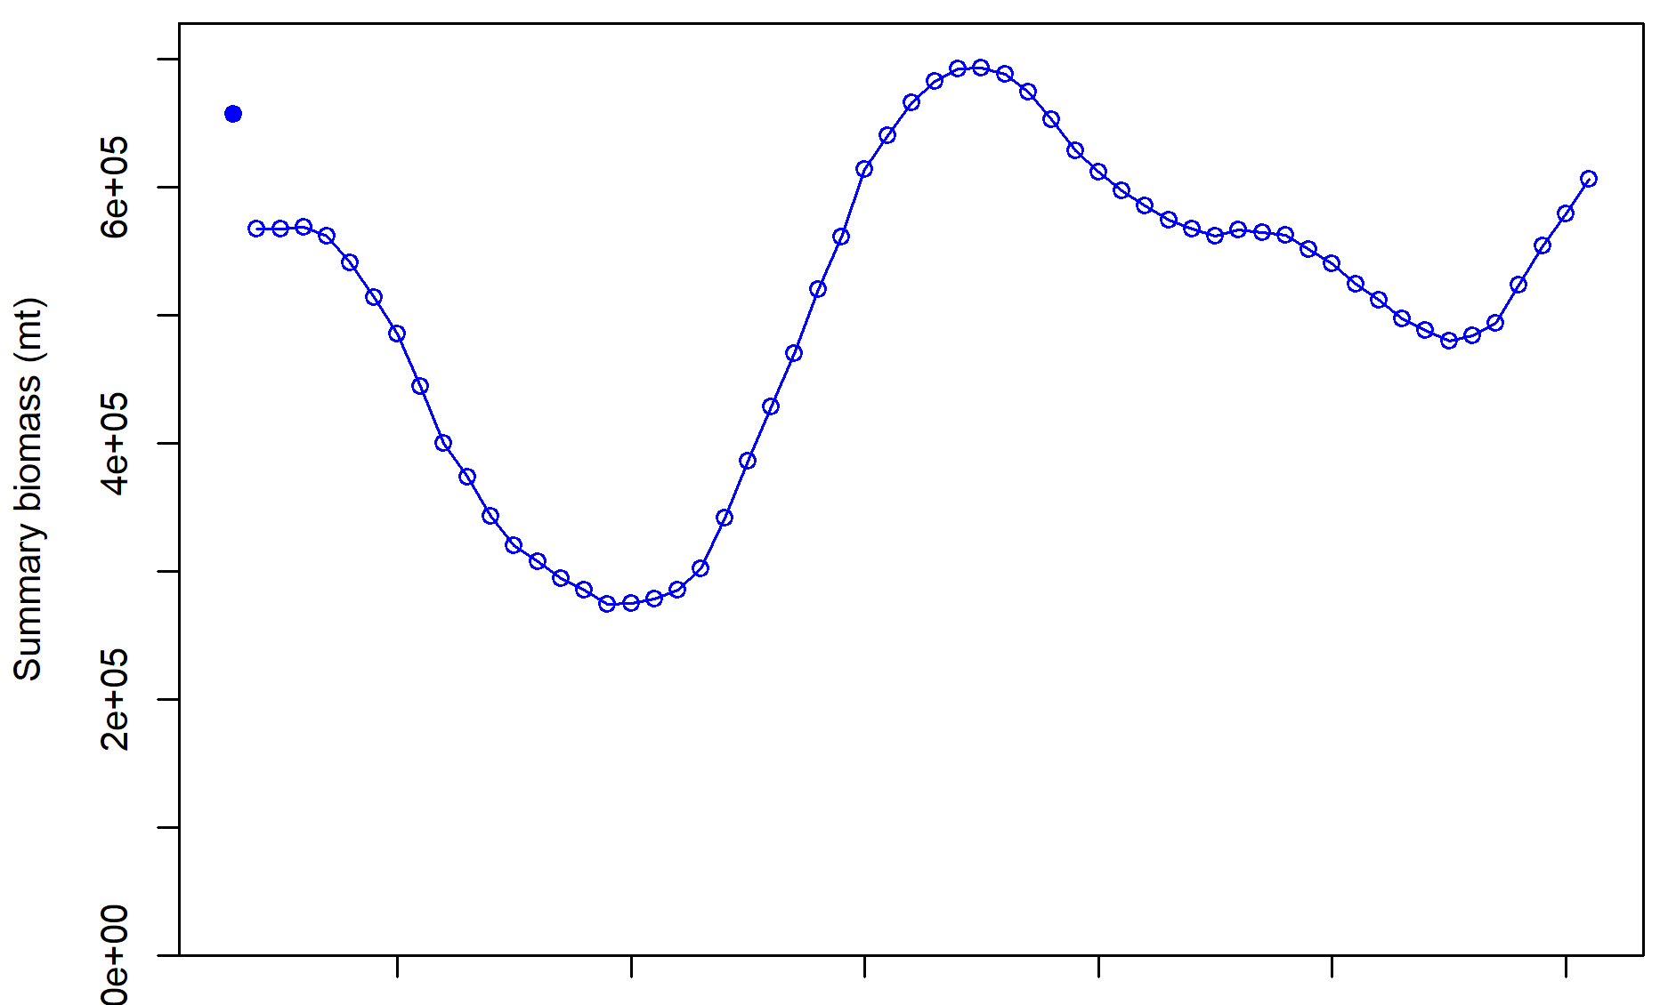
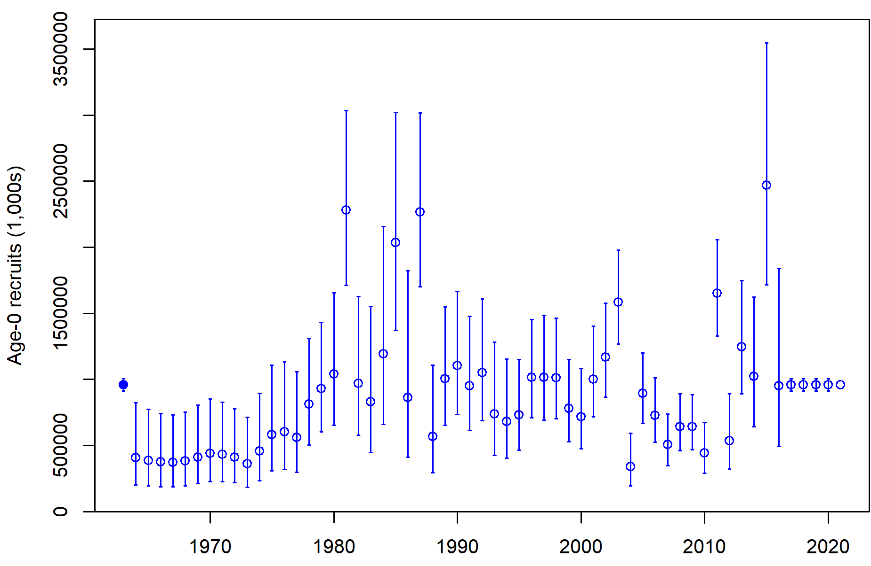
Total biomass (age 3+) is increasing due to recent large recruitments
Have not matured so SSB declining but projected to increase w/ similar catches

Slide 18
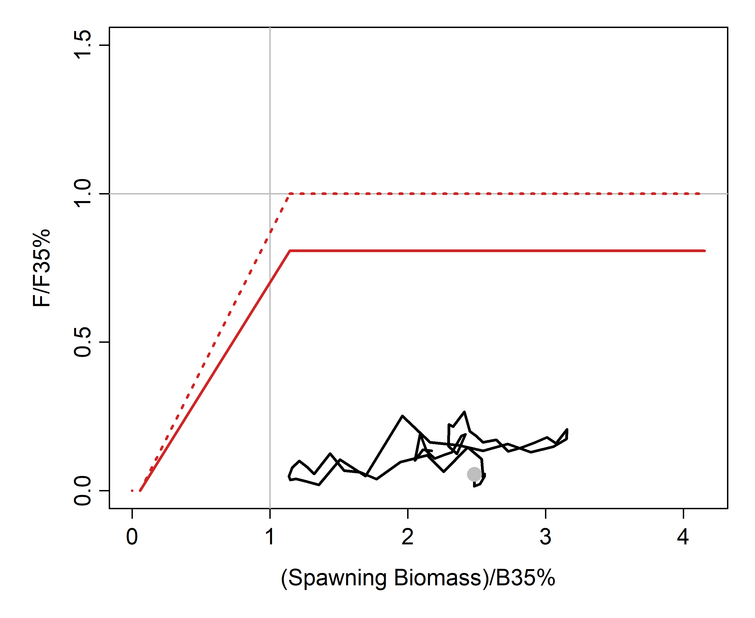
Status trends

Slide 19
Risk table
Model fits well, consistently above target biomass
Data suggest no apparent ecosystem concerns, although predation pressure may be rising (E. Siddon)
No ESP, but catches fraction of ABC (~16%)

Slide 20
Future work
Explore estimation of natural mortality (& catchability?)
Revisit temperature/catchability relationship using VAST, which would allow for more sophisticated relationships (e.g., spatially-varying cold pool effect)
Split pelagic trawl fishery off and estimate separate selectivity
Use VAST to estimate BS & AI joint index, replacing the linear regression approach used

Slide 21
Questions? Discussion?
Quantity | As estimated or |  | As estimated or
 | specified last year for: |  | recommended this year for:
 | 2020 | 2021 | 2021* | 2022*
M (natural mortality rate) | 0.2 | 0.2 | 0.2 | 0.2
Tier | 3a | 3a | 3a | 3a
Projected biomass (3+) (t) | 684,768 | 692,915 | 602,497 | 608,576
Projected SSB (t) | 154,195 | 160,864 | 150,433 | 154,906
B_{100%} | 212,060 | 212,060 | 203,658 | 203,658
B_{40%} | 84,824 | 84,824 | 81,463 | 81,463
B_{35%} | 74,221 | 74,221 | 71,280 | 71,280
F_{OFL} | 0.47 | 0.47 | 0.46 | 0.46
maxF_{ABC} | 0.38 | 0.38 | 0.37 | 0.37
F_{ABC} | 0.38 | 0.38 | 0.37 | 0.37
OFL (t) | 82,810 | 86,432 | 75,863 | 77,763
maxABC (t) | 68,134 | 71,079 | 62,567 | 64,119
ABC (t) | 68,134 | 71,079 | 62,567 | 64,119
Projections based on estimated catch:
8,669 t in 2020
11,519 t in 2021
11,519 t in 2022
62,567 t is 8.17% decrease in ABC from 2020

